Slide 1
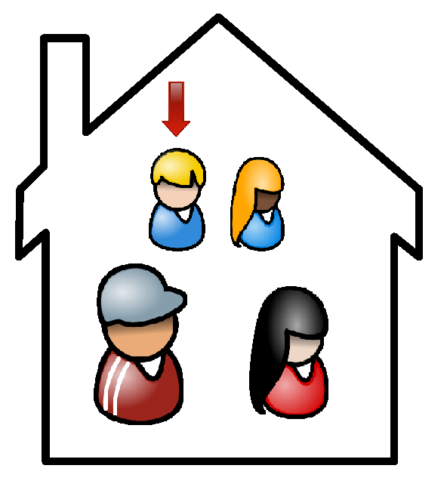
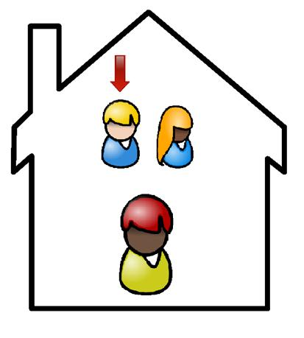
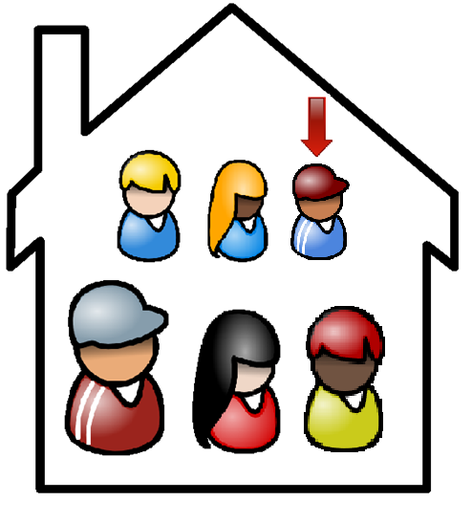
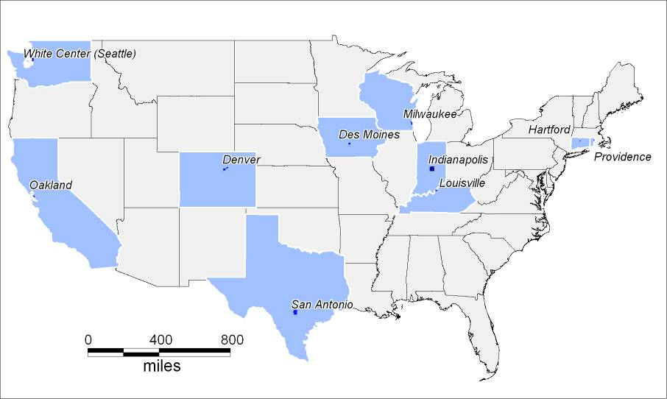
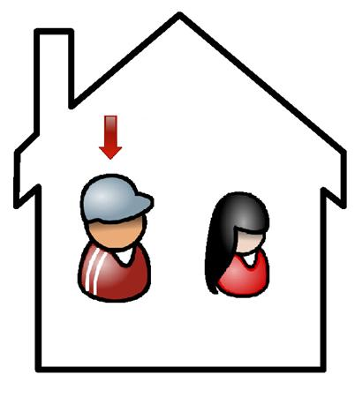
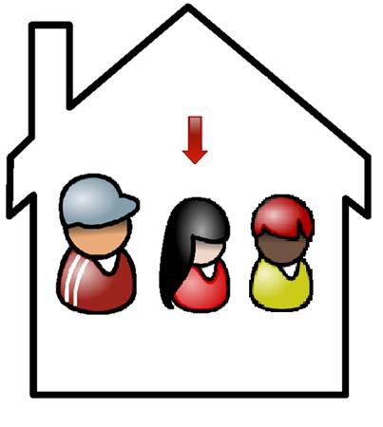
A Moving Target: The Effect of Changing Respondents in a Panel Survey of Households Beth Fisher, Kate Bachtell, Ned English, Cathy Haggerty NORC, Chicago, Illinois
Abstract
How do we get different respondents?
Demographics
Making Connections is a study of ten urban communities throughout the United States, funded by the Annie E. Casey Foundation. The study employs a unique hybrid sampling design that combines a cross-sectional focus on neighborhoods and a panel survey of households with children. In the baseline, we employed a semi-random approach that prompted interviewers to use a Kish table to select an adult to act as the respondent in adult-only households. In households with children, interviewers randomly selected a minor to serve as the “focus child” and then asked to speak with the parent or guardian who knew the most about the focus child (respondent selection was non-random). In Waves 2 and 3 the screening procedure was driven by two main criteria: 1) whether or not there were children in the household at the time of the interview with the “current household” and 2) whether or not the current household composition had changed since the previous wave. Using the data from two waves (gathered in 2002-2004 and 2005-2007), we examine the extent to which switching respondents produced substantive changes in the survey data. We draw from prior comparisons of respondent selection procedures (Oldendick et al 1988, etc.) to investigate the tradeoffs associated with semi-random respondent selection. Our discussion tackles the difficult question of how much survey data reflects the perceptions of behaviors and conditions rather than the experiences themselves (Duncan and Kalton 1987, 109).
Scenario One
 | Same Respondent |  | Different Respondent
 | Wave 1 | Wave 2 | Wave 1 | Wave 2
Respondent is a US citizen | 89% | 90% | 82% | 88%
Respondent has high school education or less | 61% | 60% | 70% | 67%
Respondent is female | 67% | 68% | 58% | 61%
Average number of adults in household | 1.78 | 1.82 | 2.35 | 2.62
Households with children | 37% | 46% | 43% | 59%
Average number of children in household (excluding households with no children) | 2.17 | 2.16 | 2.01 | 1.98
Percentage of households that went from no children to having children in wave 2 or vice versa | - | 12% | - | 33%
Average respondent age | 46.66 | 49.63 | 46.82 | 40.40
Percent that own home | 40% | 42% | 41% | 34%
3 years later
Introduction
Wave 1: Boy is randomly selected as the focal child. Adult that knows the most about the boy and is living in the household is interviewed.
Wave 2: Boy still lives in household, so remains selected focal child. Again, the adult that knows the most about the boy and is living in the household is interviewed, even if that was not the same adult as in wave 1.
Percentages highlighted in blue below indicate significant at the p=.05 level
Making Connections is a neighborhood-based longitudinal, in-person study
Two waves of data available (2002-2004; 2005-2007), with third wave of data collection underway (2008-2011)
Targets between 700 and 800 interviews in ten urban neighborhoods
Interviews are completed by telephone and in person
Questions concerning neighborhood engagement, children, income and assets, and perceptions of neighborhood
Longitudinal data set includes households that stayed at the same address, as well as households that moved if there was a child under the age of 18 present in wave 1
Approximately 45% of households stayed in wave 1 housing unit, which is the focus of our investigation
Of these households, approximately 10% had different respondents speaking on behalf of the household
What are the implications for Making Connections and subsequent policy decisions?
Would like to learn:
How does this affect reported answers for variables that should remain consistent over time?
How do variables that capture neighborhood perceptions change among households with the same respondents relative to those with different respondents?
Types of Loans Held by Respondent
 | Same Respondent |  |  | Different Respondent
 | Wave 1 % Have | Wave 2 % Have | % Changed Answer | Wave 1 % Have | Wave 2 % Have | % Changed Answer
Home mortgage | 31 | 31 | 11 | 34 | 26 | 20
Home improvement loan | 6 | 5 | 8 | 7 | 3 | 7
Home equity loan | 6 | 8 | 10 | 7 | 5 | 9
Car loan | 24 | 21 | 21 | 23 | 24 | 27
Student loan | 10 | 11 | 8 | 11 | 13 | 14
Credit card balance | 39 | 28 | 24 | 37 | 31 | 35
Scenario Two
3 years later
Perceptions of Neighborhood Conditions by Respondent
Wave 1: Boy is randomly selected as the focal child. Adult that knows the most about the boy and is living in the household is interviewed.
Wave 2: A new child and parent move into the household. We use a Kish table to select a focal child because a new child has been added to the household. In this example, the new child is selected to be the focal child and the adult that knows the most about the child, who happens to be a new adult, becomes the respondent.
 | Same Respondent |  |  | Different Respondent
 | Wave 1 % Agree | Wave 2 % Agree | % Changed Answer* | Wave 1 % Agree | Wave 2 % Agree | % Changed Answer*
Neighborhood is safe for children | 51 | 53 | 42 | 54 | 53 | 53
I feel safe at home at night | 72 | 73 | 32 | 75 | 72 | 40
On Halloween, most of the children go trick or treating in this neighborhood | 48 | 52 | 44 | 52 | 50 | 52
Most criminal activity going on here is committed by people living outside neighborhood | 52 | 56 | 47 | 50 | 55 | 53
If someone stopped me at night to ask directions, I would probably stop to speak with them | 38 | 38 | 41 | 40 | 36 | 54
Scenario Three
3 years later
* Changes from all three categories, agree, disagree, and do not have feelings included in this column
Reported Use of Neighborhood Services by Household
 | Same Respondent |  |  | Different Respondent
 | Wave 1 % Use | Wave 2 % Use | % Changed Answer | Wave 1 % Use | Wave 2 % Use | % Changed Answer
Bank or Credit Union | 84 | 82 | 16 | 85 | 84 | 18
Check Cashing Services | 29 | 28 | 29 | 32 | 36 | 41
Money Transfer Service | 24 | 21 | 25 | 26 | 25 | 33
Basic Medical Care and Services | 86 | 84 | 20 | 85 | 85 | 25
After School Programs | 23 | 22 | 21 | 31 | 25 | 27
Community College/Adult Education | 29 | 29 | 26 | 34 | 36 | 31
Park or Playground | 72 | 66 | 28 | 70 | 72 | 35
Recreation/Community Center | 35 | 35 | 35 | 34 | 33 | 37
Library | 64 | 63 | 26 | 68 | 69 | 28
Child Care Services | 15 | 12 | 16 | 15 | 13 | 17
Employment Placement | 19 | 17 | 22 | 23 | 18 | 28
Place to sign up for TANF/Welfare | 23 | 22 | 20 | 23 | 27 | 23
Family Counseling or Other Family Support | 12 | 10 | 15 | 12 | 12 | 17
Wave 1: No children living in household. Adult is randomly selected to be the respondent.
Wave 2: A new adult is added to the household. Because household composition has changed, we again randomly select an adult. In this case, we happen to select a different respondent.
Analytical Approach
Number of Households with Same and Different Respondents by Site
Identify households
Use households that have not moved between waves 1 and 2
Use roster data to identify households that had the same or a different respondent between waves.
Compare responses to substantive questions over time to determine:
If having a different respondent changes responses over time?
Can the two groups can be analyzed together?
Site | Total “Stayer” Households | Percentage Same | Percentage Different
Denver | 299 | 90% | 10%
Des Moines | 264 | 88% | 12%
Hartford | 152 | 90% | 10%
Indianapolis | 271 | 82% | 18%
Louisville | 198 | 95% | 5%
Milwaukee | 144 | 84% | 16%
Oakland | 244 | 85% | 15%
Providence | 246 | 86% | 14%
San Antonio | 260 | 84% | 16%
Seattle/White Center | 338 | 86% | 14%
Total | 2590 | 87% (2246) | 13% (344)
Discussion and Conclusions
Methodology
The Making Connections design is essential to collecting the best possible data about children living in the household. However, the group with different respondents between waves had a higher proportion of changes in response for the questions we examined
Question type appears to have some affect on the amount of change for households with different respondents. More change is seen in questions that focus on the respondent or rely on the respondent’s perception or opinion
Possible remedies
Remove this data from longitudinal analyses and include it in cross-sectional analyses only
Design or word questions in such a way to minimize influence of respondent’s opinions, personal experiences, or perceptions on questions
Consider alternative methods of selecting a respondent if there is the potential for changes in the composition of a household. For example, if a different respondent is randomly selected in subsequent waves of data collection, we could make every effort to have the original respondent from the prior wave to answer questions that we wish to follow over time.
Important to be aware of how respondent selection procedures will shape data analyses, particularly as it relates to longitudinal analysis. Clearly, there is a relationship between having a different respondent answer a question and changing responses between waves.
Selected different questions that ask about the following:
Respondent and household demographics
Individual respondent financial decisions made on behalf of the household
Individual respondent perceptions of the neighborhood
Services used at the household level
Compare responses of each group over time
Calculate the percentage of responses that changed between waves for both households that had the same respondent and households that had different respondents
Using binomial tests, compare percentage of change in responses for households with a different respondent to “ideal” longitudinal households – those that did not change respondents between waves.

